Slide 1
Understanding Your PSAT Results

Slide 2
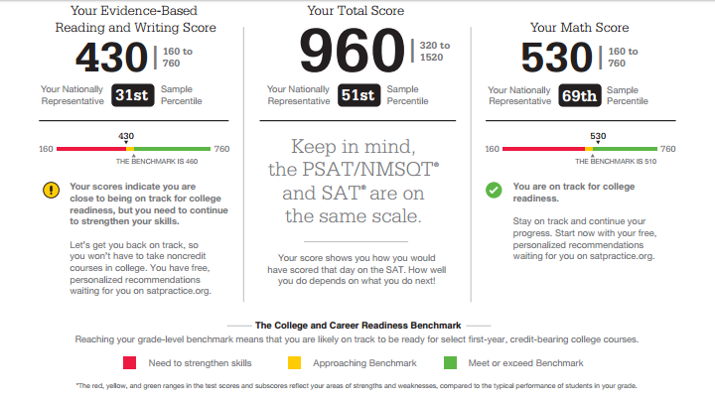

Slide 3
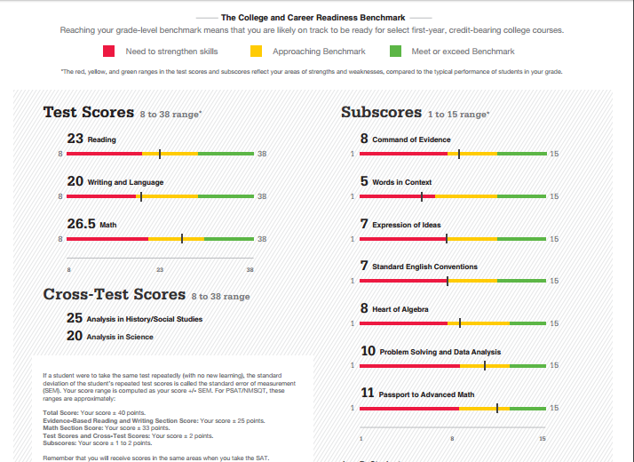
This information is found in your online score report

Slide 4
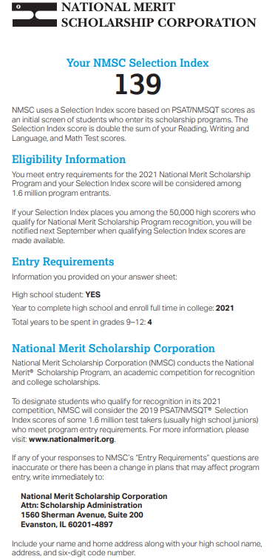

Slide 5
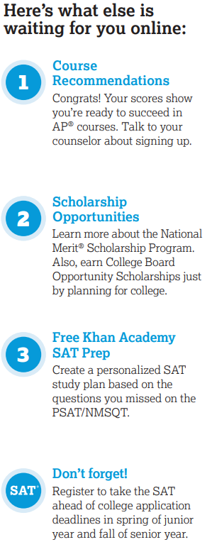

Slide 6
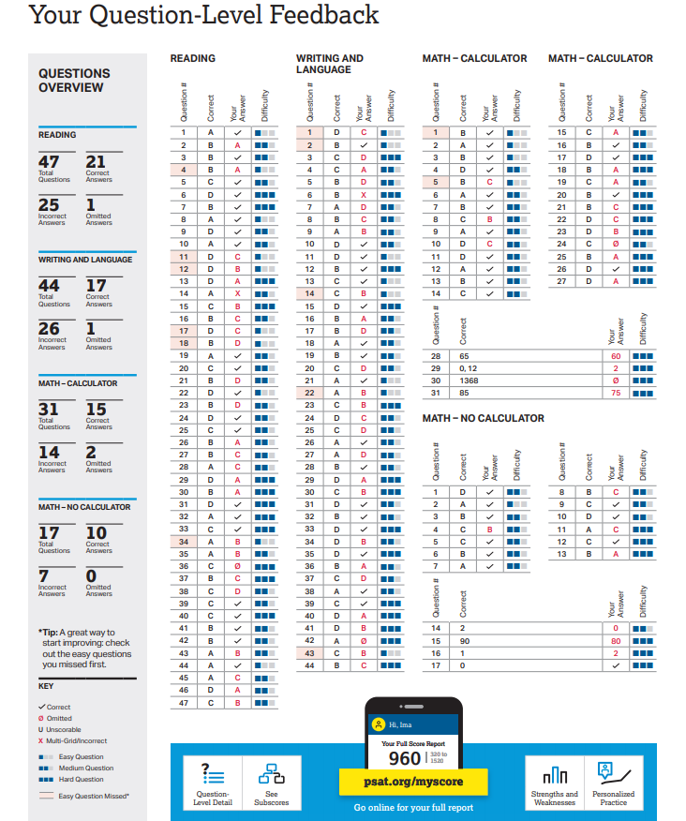

Slide 7
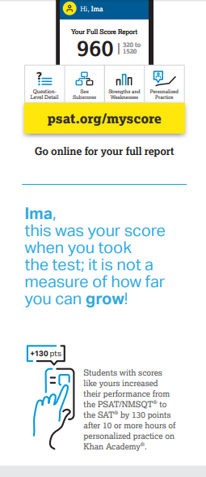

Slide 8
Still have questions?
Make an appointment to see your school counselor
Attend an informational flex session
Email your specific question to your school counselor

Slide 9
Communication
School website
Student email
Flex sessions
Individual appointments
School newsletter
TV news

